Slide 1


21MAT204
MATHEMATICS FOR INTELLIGENT SYSTEMS - 5
END SEMESTER PROJECT

Slide 2
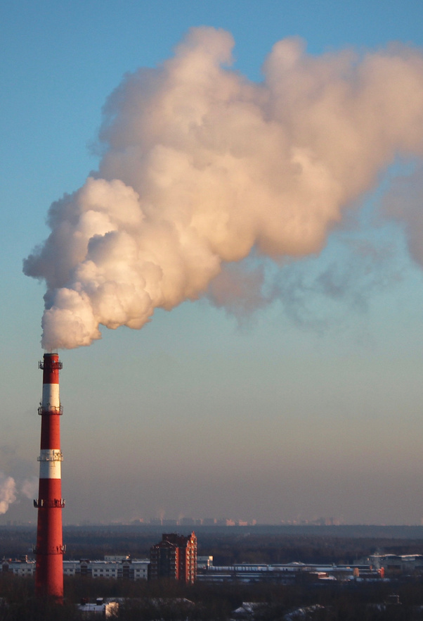

Predicting International Carbon Dioxide and Greenhouse Gas Emission Levels with Dynamic Mode Decomposition and LSTM

Slide 3





Team - 11
Divith
Karnati Sai Prashanth
Sai Rishith
SVS Dhanush
Ganesh Kumar
CB.EN.U4AIE20013
CB.EN.U4AIE20027
CB.EN.U4AIE20036
CB.EN.U4AIE20068
CB.EN.U4AIE20073

Slide 4
AIM
Apply Dynamic Mode Decomposition and LSTM on the United Nations' International GreenHouse Inventory Data to predict the Annual CO2 and GHG emittions in the future.

Slide 5
Why this Topic ?
floods
sea level
hurricanes
extinction
example
GHG is the main culprit behind climate change and CO2 is the largest contributor to GHG emissions.
40
30
Global mean surface air temperature went up an estimated 1.53 degrees Fahrenheit from 1880-2012.
20
10
0
Increase in global average temperature rises risk of Natural cosmetics.
" Estimates on future global average temperature depend on future
GHG emission levels. "

Slide 6

DATASET
We have used United Nations' International Greenhouse Gas (GHG) Inventory Dataset for this project.
It contains the annual CO2 and GreenHouse emissions from 1990 to 2014 along with the countries.
we also have comparison data which contains data from 2015 to 2020.
we have used this data to compare how accurate is our DMD predicted results.

Slide 7
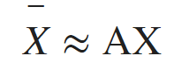
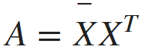
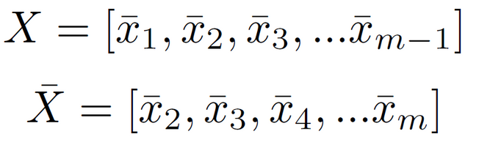
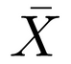
DMD Formulation
Finding the best-fit solution for the operator A for all pairs of measurements
X -> array of vectors
X1 -> column containing the CO2 emissions of every country or area in the year 1990.
X(m-1) ->column containing the CO2 emissions of every country or area in the year 2013.
-> array of vectors
X2 -> column containing the CO2 emissions of every country or area in the year 1991.
X(m) ->column containing the CO2 emissions of every country or area in the year 2014.

Slide 8
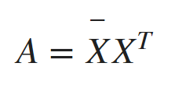
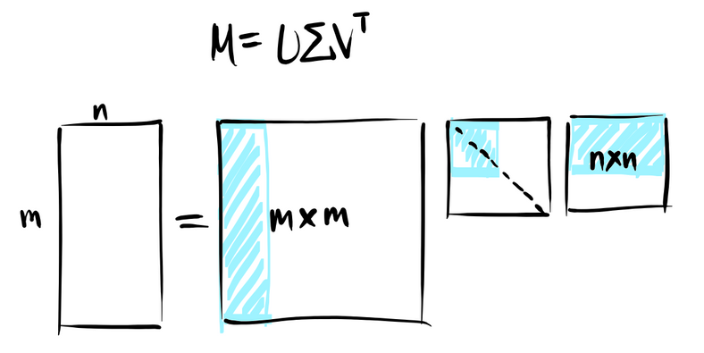


SVD
m x n
A computationally efficient and accurate method for finding the pseudoinverse is via the SVD
r x r - non zero values
we perform the Singular Value Decomposition (SVD) for the matrix X. which captures the dominant correlation structures in the data
U is an array of the eigenvectors of XX*
V is an array of the eigenvectors of X*X
is a rectangular diagonal matrix whose diagonal entries are called .

Slide 9
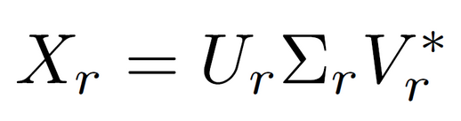

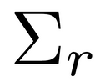
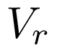
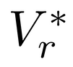
RANK
we calculate the rank of the matrix X.
let the rank be equal to r, such that r is equal to the number of linearly independent columns in X.
Now, we will be taking only those r columns and Rows for our calculations
After taking r rows/columns :
Where ,
square matrix containing the first r rows and the first r columns of
matrix containing the first r columns of U
matrix containing the first r columns of V
conjugate transpose of Vr.

Slide 10
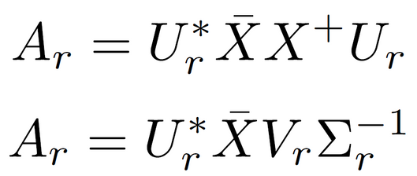
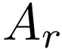
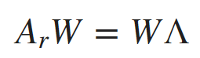

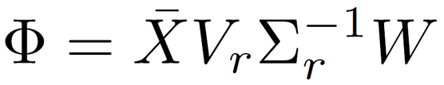
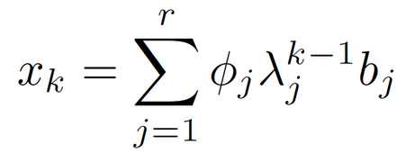

Formulation For DMD Modes
eigendecomposition of is defined by:
Yields eigenvalues and eigenvectors that can be investigated for fundamental properties of the underlying system
W is an array in which each column is an eigenvector of Ar
array in with each entry is an eigenvalue of Ar
we now calculate :
is a matrix whose columns are called the DMD modes.

Slide 11
What Results From DMD ?
xk is a column vector where each entry corresponds to the CO2 emission levels of a country or area in the data set during year k
k = 0 corresponds to the year 1990 - The first entry of x0 corresponds to the CO2 emission levels of Australia in 1990
k = 25 corresponds to the year 2015, so x25 is an estimate of the CO2 emission levels in every country or region in the data set during the year 2015
GHG DMD results use the same structure except with y instead of x

Slide 12
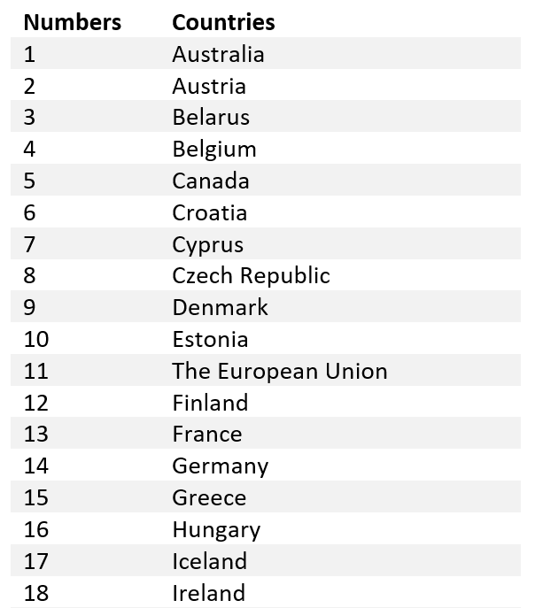
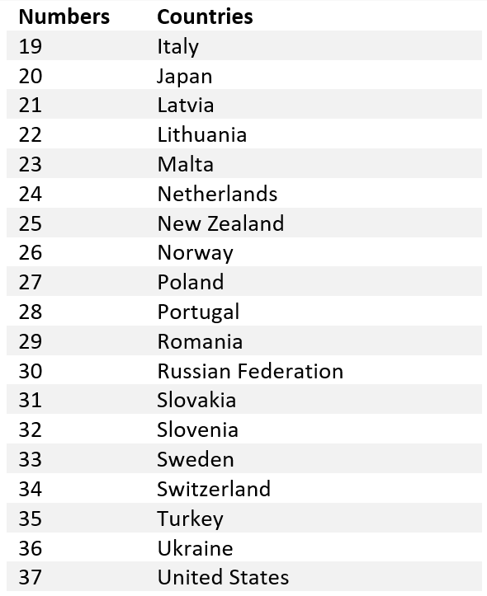
DATASET
here instead of using the Country names or codes we have used numbers to represent the country. Names are taking up a lot of space when plotting the data.

Slide 13
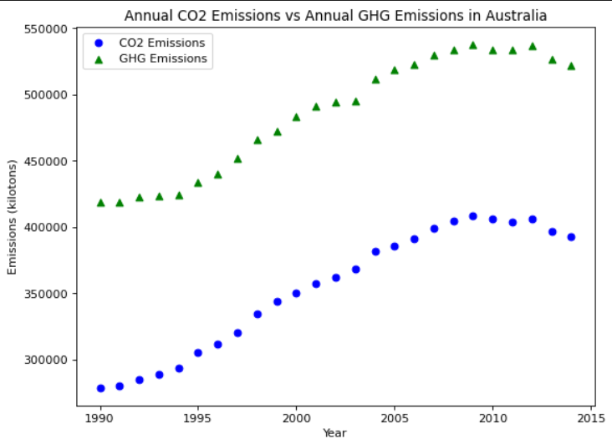
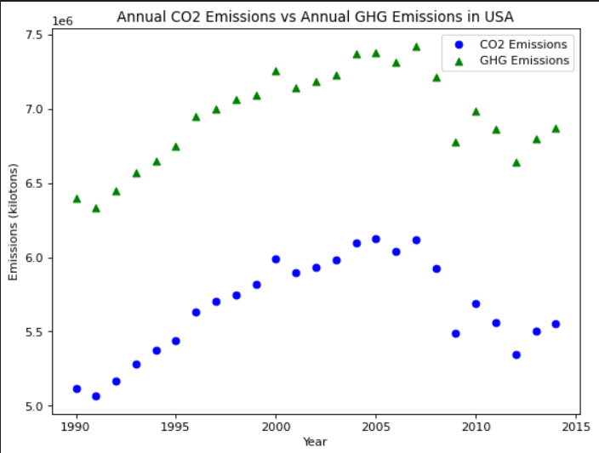
Result and Analysis
Sample Plots From Data Set
This contains all of Australia's CO2 and GHG emission data
This contains all of USA's CO2 and GHG emission data

Slide 14

Analysis on Co2 DATA

Slide 15
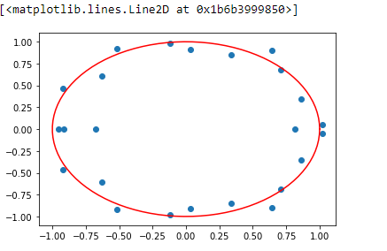
Eigenvalues Spectrum for CO2
imaginary
Real Values

Slide 16
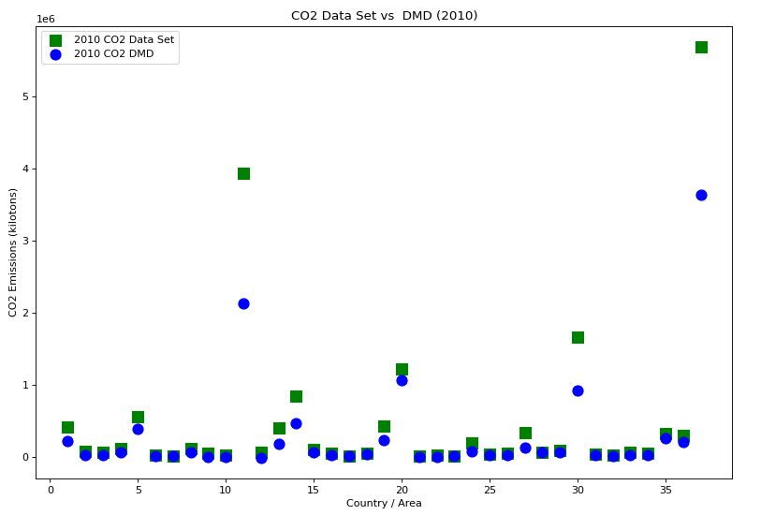
Data Set vs DMD
(2010 CO2)
Each x-axis number refers to a country or area in the data set

Slide 17
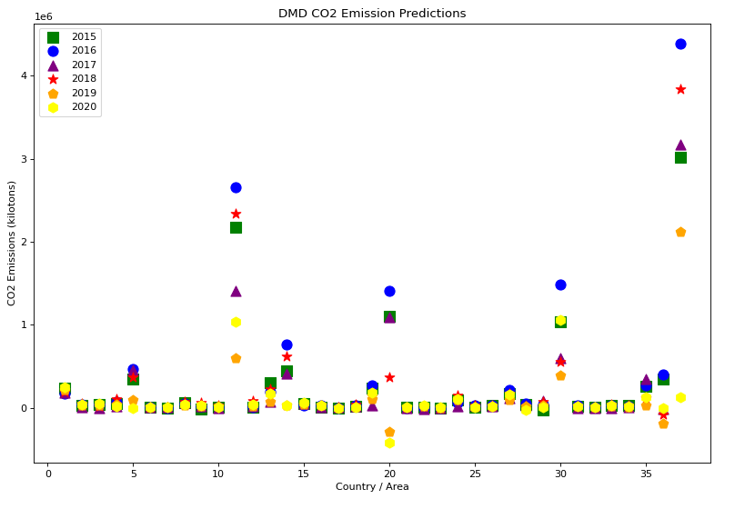
Prediction of CO2

Slide 18
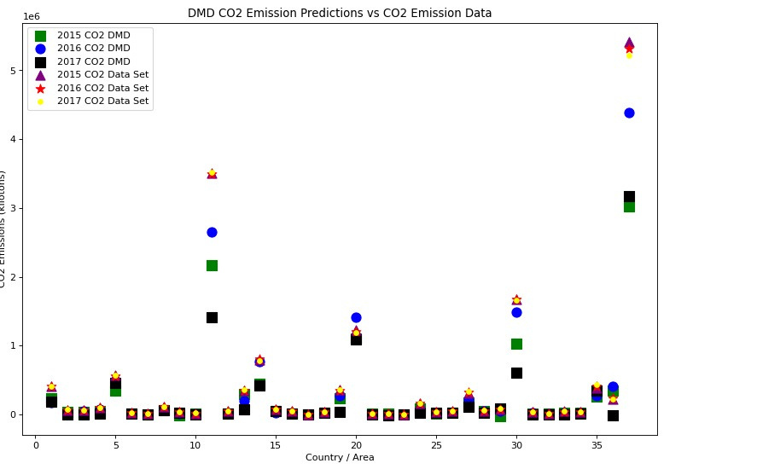
CO2 Emission Predictions vs CO2 Emission Data
2015, 2016 AND 2017 CO2 DMD PREDICTIONS VS 2015, 2016 AND 2017 CO2 DMD DATA

Slide 19
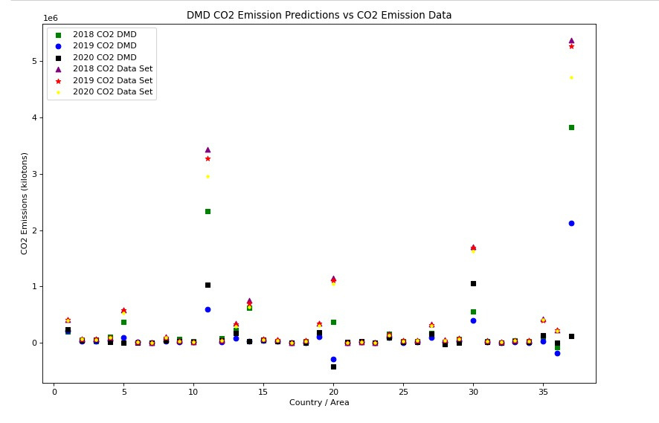
CO2 Emission Predictions vs CO2 Emission Data
2018, 2019 AND 2020 CO2 DMD PREDICTIONS VS 2018, 2019 AND 2020 CO2 DMD DATA
RMSE VALUE FOR CO2 emissions:
0.5476857867161713

Slide 20
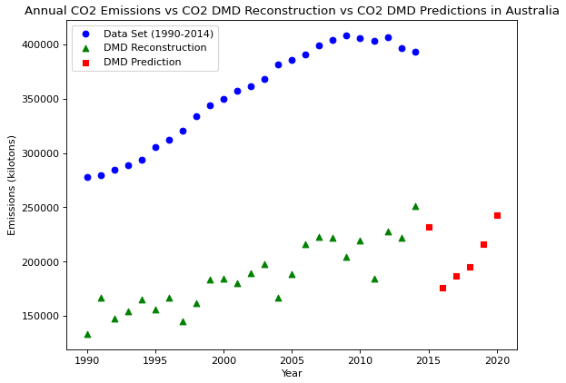
Data Set vs DMD (Australia CO2)

Slide 21

Analysis on GHG DATA

Slide 22
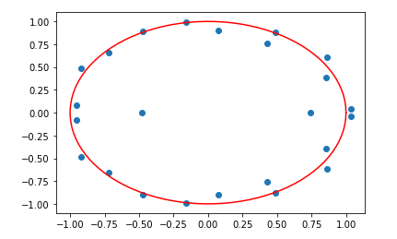
Eigenvalues Spectrum for GHG
imaginary
Real Values

Slide 23
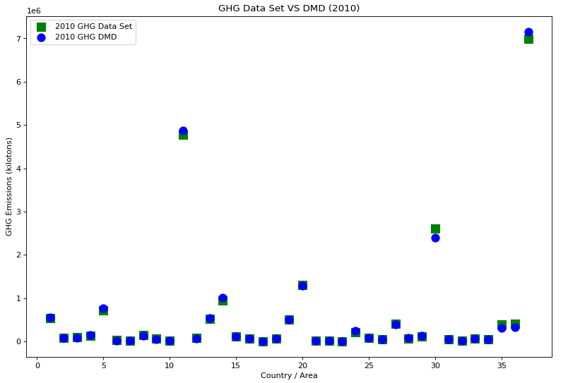
Data Set vs DMD
(2010 GHG)

Slide 24
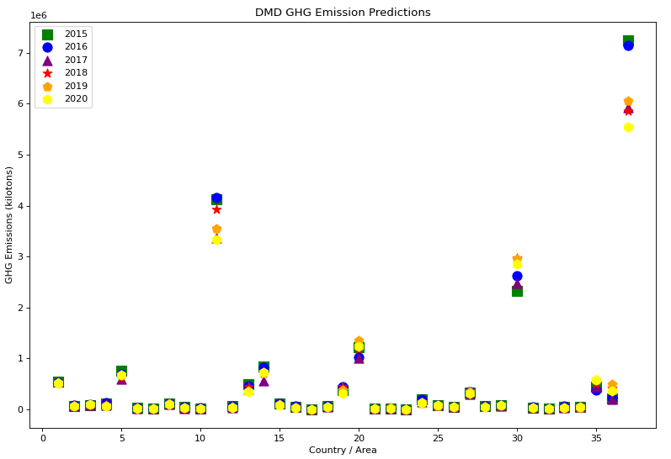
Prediction of GHG

Slide 25
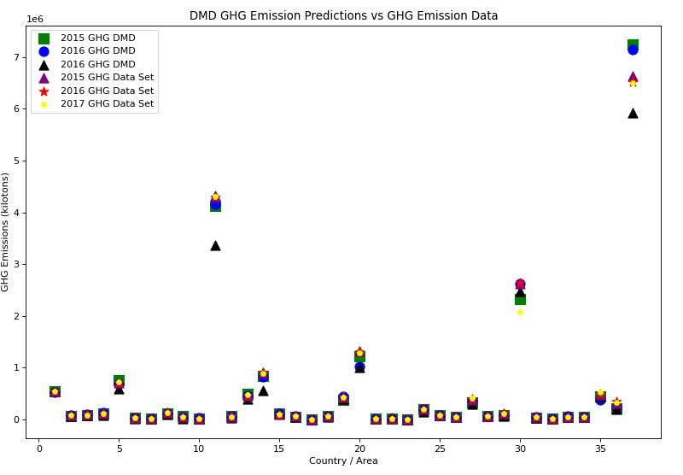
GHG Emission Predictions vs GHG Emission Data
2015, 2016 AND 2017 GHG DMD PREDICTIONS VS 2015, 2016 AND 2017 GHG DATA

Slide 26
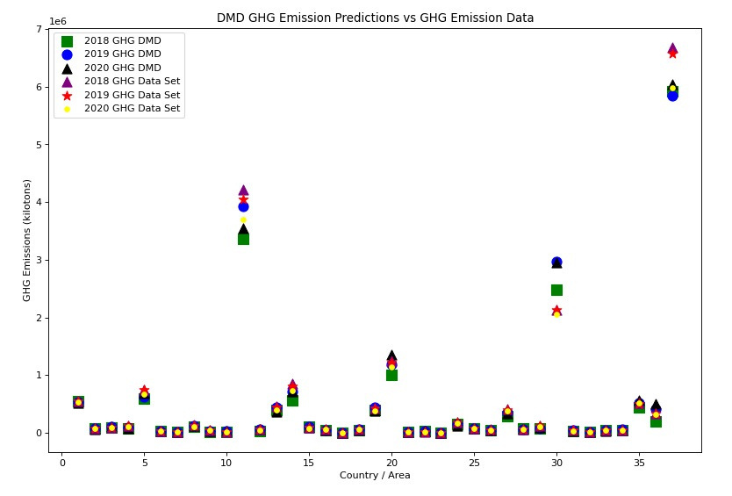
GHG Emission Predictions vs GHG Emission Data
2018, 2019 AND 2020 GHG DMD PREDICTIONS VS 2018, 2019 AND 2020 GHG DATA
RMSE VALUE FOR CO2 emissions:
0.13326824650153718

Slide 27
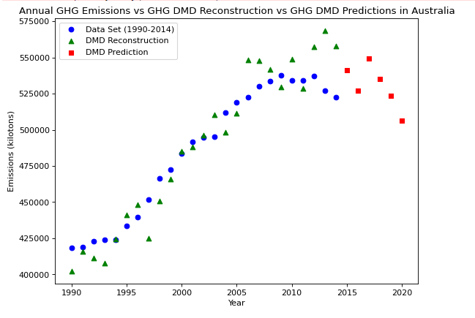
Data Set vs DMD (Australia GHG)

Slide 28
CODE
Kaggle Link:
https://www.kaggle.com/code/prashanth16/co2-and-green-gas-prediction

Slide 29
LSTM

Slide 30
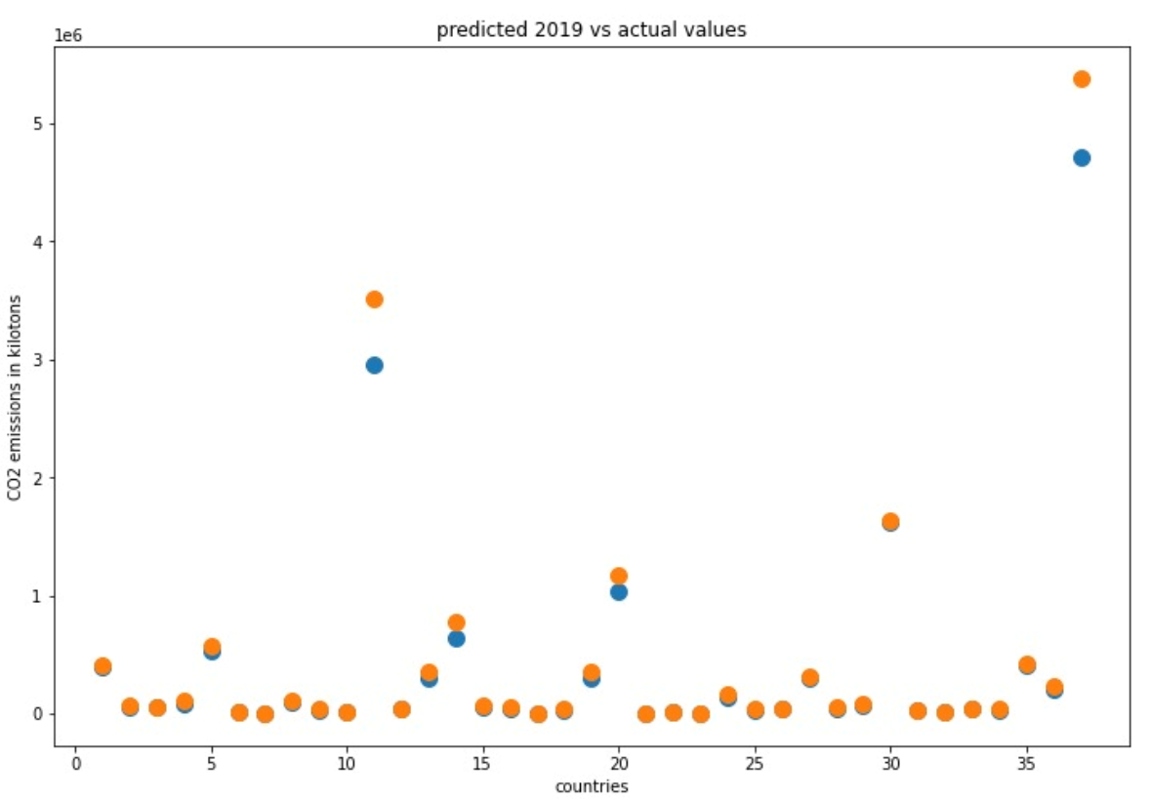
CODE
RMSE VALUE FOR CO2 emissions:
0.00823052697047146

Slide 31
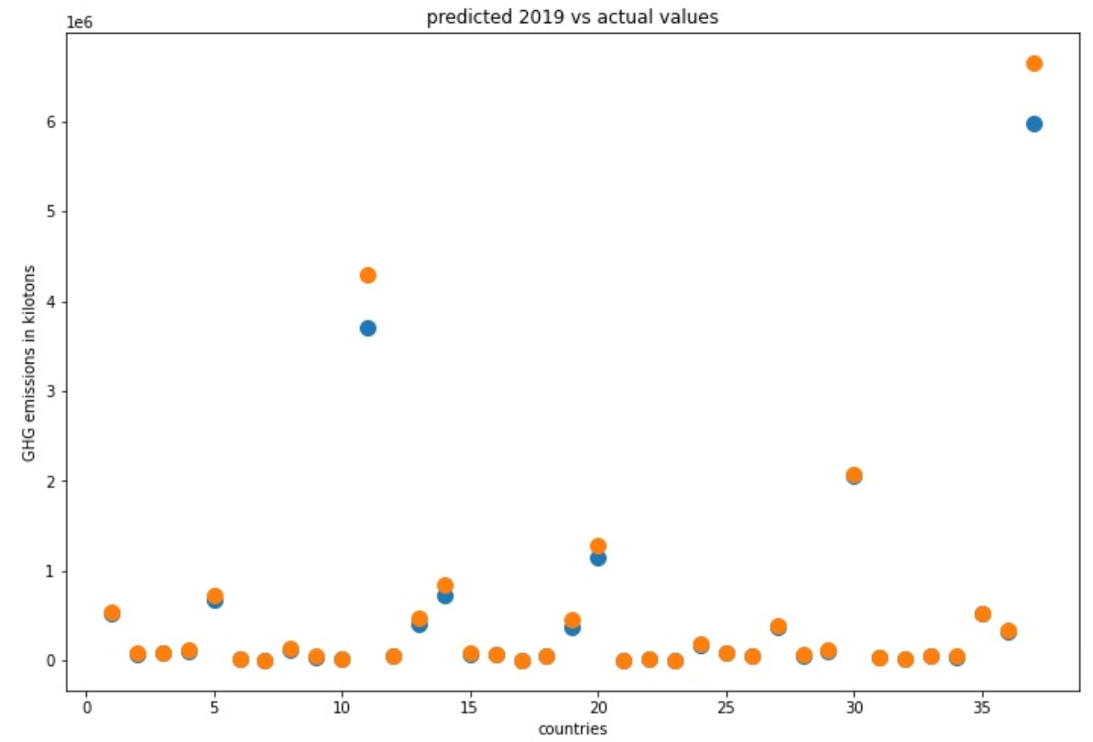
RMSE VALUE FOR GHG emissions:
0.007201323387018921

Slide 32
Results
The CO2 and GHG DMD models show similar trends in their results.
The GHG DMD models are consistently more accurate than the CO2 DMD models because of the diff?erences in the CO2 and GHG data sets.
DMD showed mixed results for predicting CO2 emission levels but very strong results for predicting GHG emission levels.
LSTM is showing more good results for both Co2 and GHG. We got the best RMSE value for LSTM compared to DMD.

Slide 33

Thank You

